Slide 1
Water Systems:Heat Capacity and Solutes

Slide 2
Objectives:
In this assignment, students will demonstrate:
that water, as compared to other substances, has a high heat capacity and is able to dissolve a wide variety of solutes.
Compare and contrast the characteristics and properties of freshwater and saltwater through engaging in the scientific inquiry loop and drawing conclusions based on data they and their classmates collected.

Slide 3
KWL on Fresh vs Salt Water Heat capacity
In the Know box list all the things you already know about fresh and saltwater.In the Wonder box write down any questions you have about fresh and saltwater. What is something you want to learn about? Leave the L box for the end of the lesson!
K
W
L
I know about Freshwater…
I know about Saltwater…
What I know
I wonder…
I wonder?
I learned…
I learned

Slide 4
I think water has a lower freezing point...
I think that water will freeze more quickly then water when left outside/in the freezer.
Saltwater
Freshwater
I think this because…
My answer…..
Place an arrow anywhere on the number line to indicate your initial thinking.
Initiating
Impossible
Possible
Certain
Image:David Gamble 2020

Slide 5
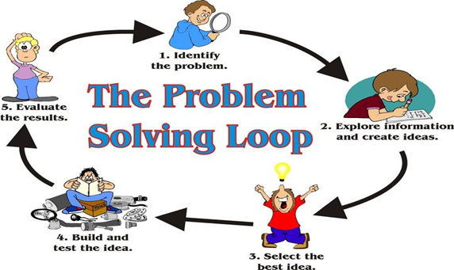
Scientific Inquiry
These bubbles are placed on the following slides to indicate where you are in the Scientific Inquiry Cycle. Match the bubble to the steps in the graphic organizer on the next slide.
Initiating
Researching
C
Planning
Demonstrating Scientific and Technological Attitudes
Implementing Plan
Reflecting
Observing, Measuring, Recording
Concluding and Applying
Analyzing and Interpreting
Image: https://pixy.org/4592163/
Image: David Gamble 2020

Slide 6
What takes longer to freeze, 250 ml of fresh water or 250 ml of salt water?
Using the Scientific inquiry loop and the graphic organizer below answer the question, fill out as you go :
What was the initiating question, wondering, problem?
What is your plan for solving/answering the problem, wondering, question?
What did you learn about this problem, wondering, question?
Implementing Plan
Concluding and Applying
Initiating
What did your research reveal?
Note what you have done, what you have noticed, and measured .
Were your first impressions correct? What did you learn? How can you use what you learned?
Research
Observing, Measuring, Recording
Reflecting
How will you solve/answer this problem, wondering, question?
What does your notes about what you did, noticed, and measured tell you?
What steps did you take to solve your problem, wondering, question? What worked? What didn't?
Analyzing and Interpreting
Demonstrating Scientific and Technological Attitudes
Planning
Image: David Gamble 2020
Teacher resource

Slide 7
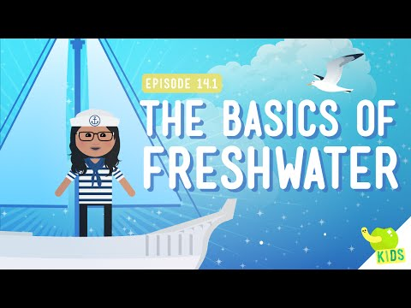
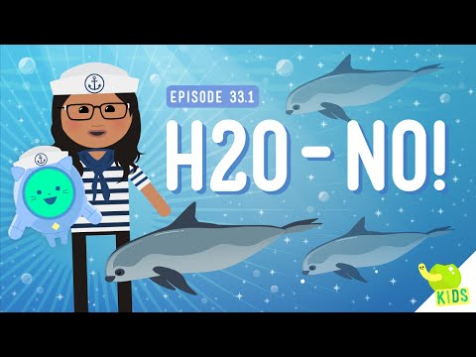
Research: please watch all videos
youtu.be/oaQCiwzjnCM
youtu.be/jNOc7mHr5gI
Researching

Slide 8
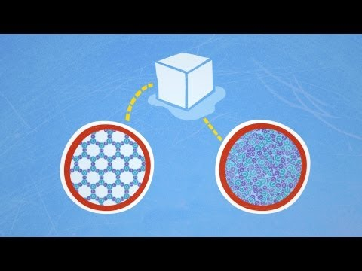
Research: please watch all videos
youtu.be/UukRgqzk-KE
youtu.be/E-M8JcYr2d4
Researching
Image: Screenshot from video
https://www.youtube.com/watch?v=UukRgqzk-KE&feature=youtu.be
Image: Screenshot from video
https://www.youtube.com/c/iitutorcom/videos

Slide 9
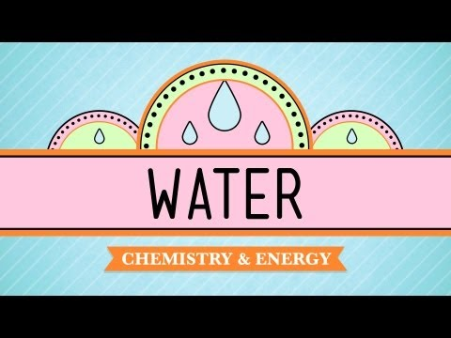
Research: please watch all videos
Chemical and Physical Properties of Ocean Water
sophia.org/tutorials/concept-5-wha…
youtu.be/HVT3Y3_gHGg
Image: Screenshot from video
https://www.youtube.com/watch?v=HVT3Y3_gHGg&feature=youtu.be
Researching

Slide 10
Experiment one:
What takes longer to freeze, 250 ml of fresh water or 250 ml of salt water?
Steps:
Prepare 250 ml of salt water by adding 25 ml of salt ( 5 teaspoons ) to 250 ml of tap water and stir for 30 seconds.
Label A and place in a freeze proof container (talk to your caregiver).
Pour 250 ml of fresh water (tap water) into and label B.
Place in a freeze proof container (talk to your caregiver)
Place both containers outside
Use the chart on the next page and record your observations in 1 hour intervals:
include description of ice formation,
a photo or drawing,
the outside temperature.
Observations end after 4 hours.
Observing, Measuring, Recording
Researching
Planning
Implementing Plan

Slide 11
Observations:Take notes and take a photo or draw a picture of the changes occuring in each container.
Researching
Observing, Measuring, Recording
Time | Outside temperature | Sketch/Drawing or photo of the water in container A | Sketch/Drawing or photo of the water in container B | Notes describing what is happening to the surface of the water. Compare containers A and B, what is the same? What is Different? What do think is happening?
1 hour
2 hours
3 hours
4 hours

Slide 12
Experiment two:
What takes longer to freeze, 250 ml of fresh hot water or 250 ml of cold fresh water?
Steps:
Prepare 250 ml of hot Fresh water (tap water) Label A and place in a freeze proof container (talk to your caregiver).
Pour 250 ml of fresh cold water (tap water) into a freeze proof container (talk to your caregiver) and label B.
Place both containers outside
Use the chart on the next page and record your observations in 1 hour intervals:
include description of ice formation,
a photo or drawing,
the outside temperature.
Observations end after 4 hours.
Observing, Measuring, Recording
Researching
Planning
Implementing Plan

Slide 13
Observations:Take notes and take a photo or draw a picture of the changes occuring in each container.
Researching
Observing, Measuring, Recording
Time | Outside temperature | Sketch/Drawing or photo of the water in container A | Sketch/Drawing or photo of the water in container B | Notes describing what is happening to the surface of the water. Compare containers A and B, what is the same? What is Different? What do think is happening?
1 hour
2 hours
3 hours
4 hours

Slide 14
Experiment three:
What takes longer to freeze, 250 ml of freshwater on top of the snow or 250 ml of freshwater buried in the snow?
Steps:
Pour 250 ml of fresh water (tap water) into two a freeze proof containers (talk to your caregiver)
Label one A and the other B.
Place container A on top of the snow.
Place container B buried in the snow.
Use the chart on the next page and record your observations in 1 hour intervals:
include description of ice formation,
a photo or drawing,
the outside temperature.
Observations end after 4 hours.
Observing, Measuring, Recording
Researching
Planning
Implementing Plan

Slide 15
Observations:Take notes and take a photo or draw a picture of the changes occuring in each container.
Researching
Observing, Measuring, Recording
Time | Outside temperature | Sketch/Drawing or photo of the water in container A | Sketch/Drawing or photo of the water in container B | Notes describing what is happening to the surface of the water. Compare containers A and B, what is the same? What is Different? What do think is happening?
1 hour
2 hours
3 hours
4 hours

Slide 16
Compare all the results from your experiments:
What type of water froze first?
Why do you think this happens?
Concluding and Applying
Analyzing and Interpreting

Slide 17
Get into collaborative groups and share your results.
Record your discussion (take notes) and answer the questions below.
Were all the results of the group the same?
What variables could have impacted the results?
How could this experiment be redesigned to limit variables?
Analyzing and Interpreting
Reflecting
Planning

Slide 18
Now I know water has a lower freezing point...
Now I know that water will freeze more quickly then water when left outside/in the freezer.
My answer…..
Saltwater
Freshwater
I think this because…
Place an arrow anywhere on the number line to indicate your understanding.
Concluding and Applying
Reflecting
Impossible
Possible
Certain
Image:David Gamble 2020

Slide 19
Please now return to the KWL on slide 3 and fill in the “What I learned” section.

Slide 20
Outcomes Addressed | Achievement Grade Profiles https://www.edu.gov.mb.ca/k12/assess/report_cards/grading/profiles.html
 | Limited | Basic | Good | Very Good to Excellent:
Science - Design Process and Problem Solving | Requires considerable, ongoing teacher support to ▪ apply strategies to solve practical problems and to explain reasoning ▪ use scientific vocabulary ▪ use criteria or constraints to define a problem and evaluate the chosen solution ▪ recognize when changes need to be made to a plan ▪ work collaboratively with peers | Requires occasional teacher or peer support to ▪ apply strategies to solve practical problems and to explain reasoning ▪ use scientific vocabulary ▪ use criteria or constraints to define a problem and evaluate the chosen solution ▪ recognize when changes need to be made to a plan ▪ work collaboratively with peers | Applies appropriate strategies to solve practical problems; requires occasional prompting to recognize when changes need to be made to a plan. Explains and justifies reasoning using appropriate science vocabulary, and generalizes to similar contexts; requires occasional prompting for clarification. Collaborates effectively with peers. | Demonstrates flexibility, resilience, and creativity when solving practical problems; critically analyzes results and makes any necessary changes to a plan. Explains and justifies reasoning clearly using appropriate science vocabulary and generalizes to other contexts. Collaborates effectively with peers, often taking a key role in group work.
8-0-3a Formulate a prediction/hypothesis that identifies a cause and effect relationship between the dependent and independent variables. GLO: A2, C2
8-0-3b Identify the independent and dependent variables in an experiment. GLO: A2, C2
8-4-01 Use appropriate vocabulary related to their investigations of water systems.
8-4-02 Demonstrate that water, as compared to other substances, has a high heat capacity and is able to dissolve a wide variety of solutes.

Slide 21
8-4-03 Compare and contrast characteristics and properties of fresh water and salt water
8-0-4a Carry out procedures that comprise a fair test. Include: controlling variables, repeating experiments to increase accuracy and reliability. GLO: C2
8-0-7a Draw a conclusion that explains investigation results. Include: explaining the cause and effect relationship between the dependent and independent variables; identifying alternative explanations for observations; supporting or rejecting a prediction/hypothesis. GLO: A1, A2, C2
8-0-7b Critically evaluate conclusions, basing arguments on fact rather than opinion. GLO: C2, C4
8-0-7g Communicate methods, results, conclusions, and new knowledge in a variety of ways. Examples: oral, written, multimedia presentations... GLO: C6

